Slide 1

Predictive Modeling for Heart Failure Outcomes
by: Khatib Mohammed & Majadly Ibrahim

Slide 2

Introduction
Objective: To predict the likelihood of fatal events in heart failure patients (DEATH\_EVENT) using various machine learning models.
Importance: Heart failure is a critical condition with high mortality rates. Predictive models can assist clinicians in identifying high-risk patients early, improving outcomes and decision-making processes.

Slide 3
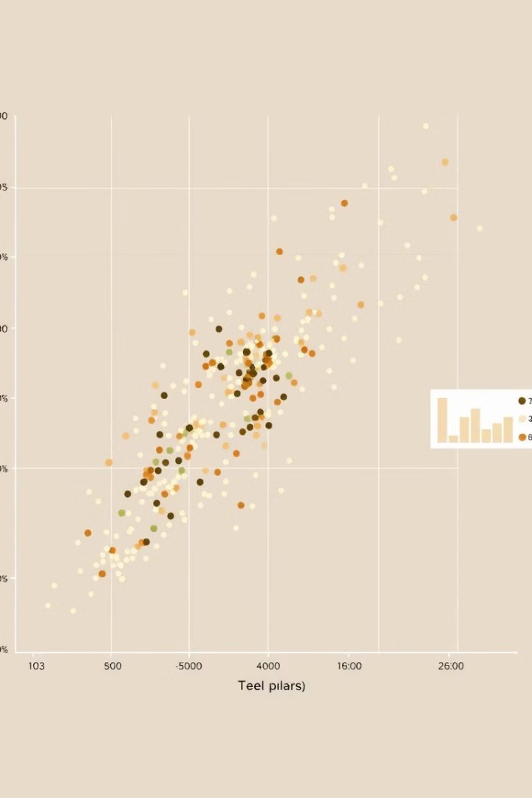
Dataset Overview
Source: Dataset includes 13 clinical and demographic features, such as age, anemia, ejection fraction, and serum sodium.
Target Variable: DEATH_EVENT (1 = fatal event, 0 = survived).

Slide 4
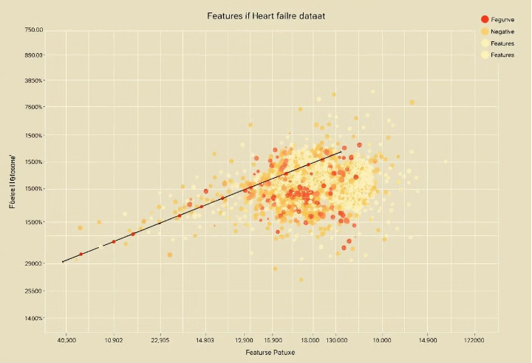
Exploratory Data Analysis (EDA)
Analysis Performed: We examined the distribution of the target variable (DEATH_EVENT) and investigated correlations between features to identify key predictors, such as age and serum creatinine. Visualizations such as heatmaps and distribution plots helped us understand the data better.
Distribution plots of key variables were created to show their ranges and distributions, assisting in identifying potential outliers or skewed data that might affect model performance. We also looked at the relationship between these distributions and the target variable to see if patterns emerged.

Slide 5

Models Implemented
Baseline Model
Advanced Model (Logistic Regression)
Predicted the most frequent class in the training dataset. Served as a reference point for evaluating advanced models.
Logistic Regression with class weights to handle data imbalance. Balanced data using SMOTE (Synthetic Minority Oversampling Technique).
Basic Neural Network
Advanced Neural Network
A simple feed-forward neural network with two hidden layers. Used L2 regularization and Dropout to reduce overfitting.
A more complex architecture with three hidden layers, Batch Normalization, and dynamic learning rate adjustment. Included Early Stopping to prevent overfitting.

Slide 6

Techniques Used
1
Data Balancing with SMOTE
2
Early stopping
3
Evaluation Metrics
Accuracy, Precision, Recall, F1-Score to provide a comprehensive assessment of model performance.
Generated synthetic samples for the minority class (fatal events) to address class imbalance .
used to avoid overfitting when training a model with an iterative method

Slide 7
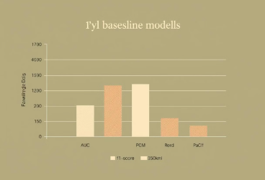
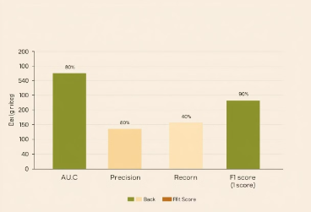
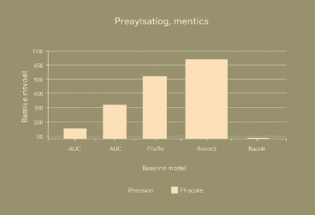
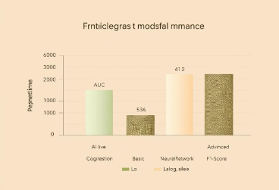
Results
The baseline model demonstrated limited predictive capabilities, exhibiting low recall for the minority class.
Employing SMOTE to balance the dataset significantly improved the logistic regression model's precision and recall.
The basic neural network effectively captured non-linear relationships within the data, outperforming the baseline model.
The advanced neural network achieved the demonstrated superior performance across all metrics, surpassing all other models.

Slide 8

Conclusion
Key Takeaways: Advanced machine learning and deep learning models significantly improved predictions for heart failure outcomes. Techniques like SMOTE and hyperparameter tuning were essential for handling data challenges.

